Slide 1

“Radical Transformation”
1:11 – 24
Week 3
2 February 2022

Slide 2
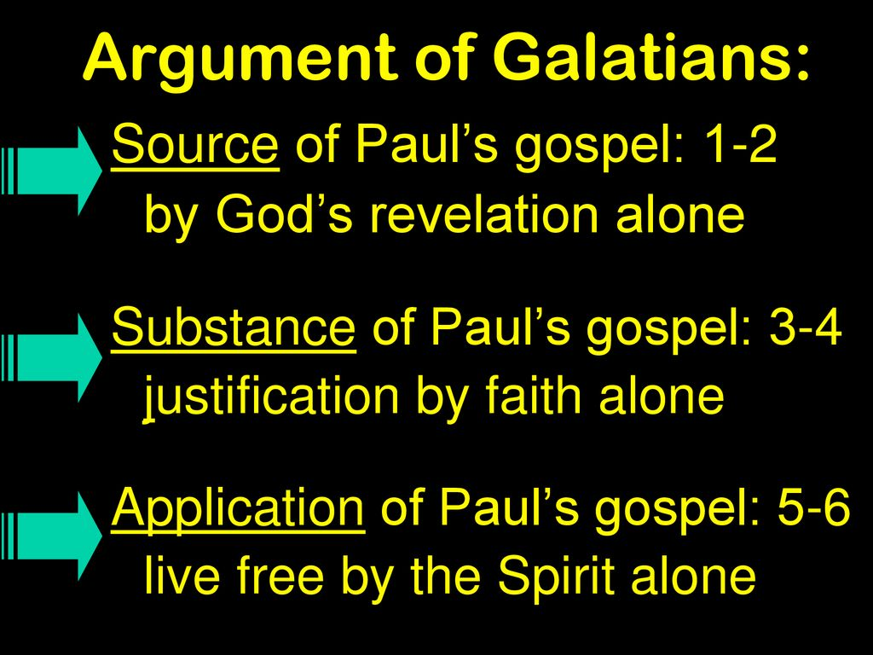

Slide 3
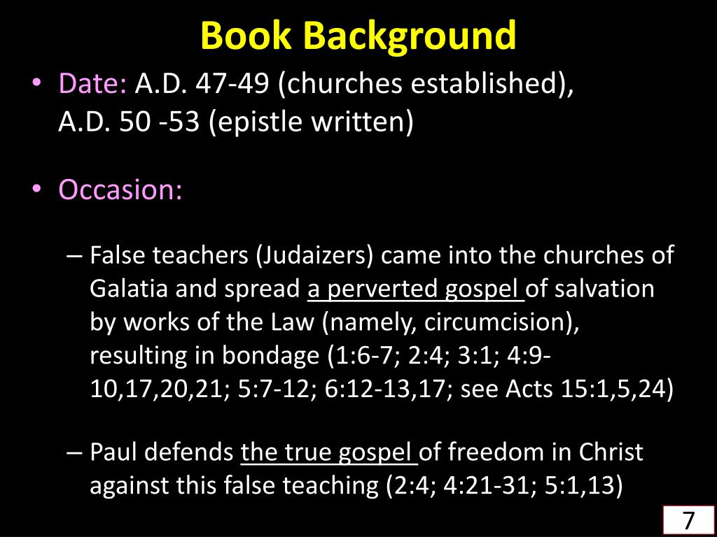

Slide 4
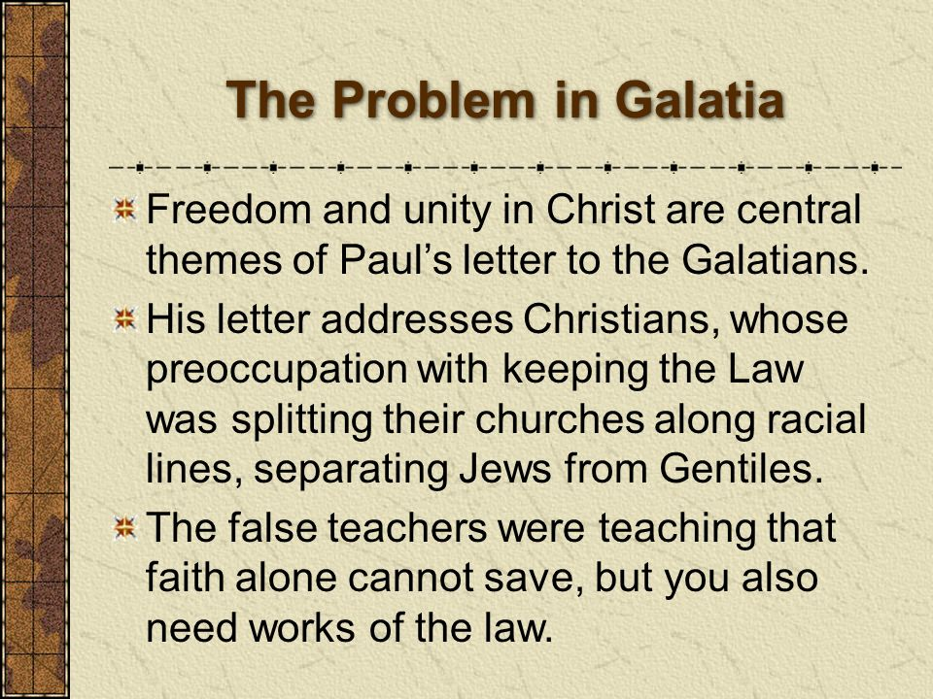

Slide 5
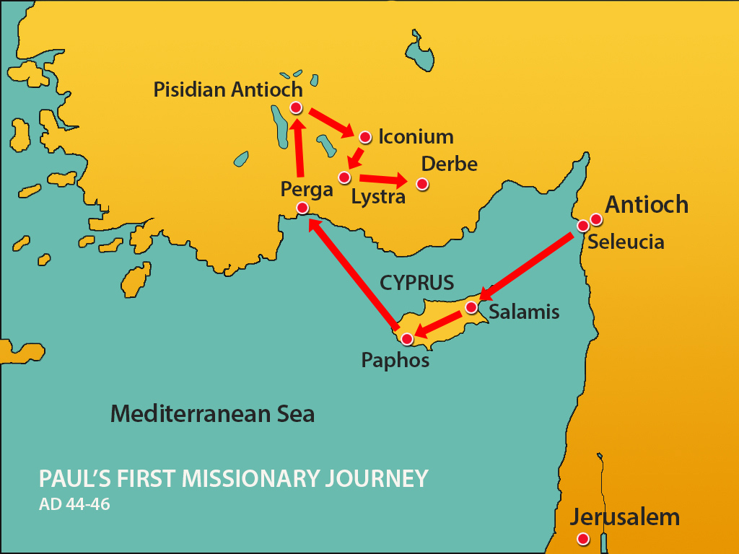
Churches
of
Southern Galatia

Slide 6

Galatians
Review Questions:
1) In identifying himself as an apostle, what point does Paul stress? (v1)
2) To whom is this epistle written? (v2)
Why did Jesus give Himself for our sins? (v4)

Slide 7
Galatians
Review Questions:
4) Why did Paul marvel? (v6)
5) What were those who were troubling them actually doing? (v7)
6) What does Paul say of those who would preach a different gospel? (v8-9)

Slide 8

Radical Transformation

Slide 9
Galatians
Background:
Shortly after Paul and Barnabas boarded their ship in southern Asia Minor to head back to Antioch, the Judaizers attacked the churches in southern Galatia. Attempting to hijack the new churches and to take the infant believers hostage with a false gospel of works righteousness, the Judaizers began by questioning whether Paul had really been called as an apostle after all.
Think about their strategy. In order to create doubt in the Galatians’ minds regarding the message, they had to create doubts about the messenger. If they could exaggerate the gap between Paul and Jesus, then the origins of Paul’s gospel would be thrown into question . . .

Slide 10
Galatians
Background:
And if they could drive a wedge between Paul and the other apostles, then they could force their own “gospel” in through the broadening crevice.
Surely, they pointed out that Paul was a Johnny-come-lately who had never even heard Jesus preach or teach. Furthermore, Paul and Barnabas had been sent by the church in Antioch, whereas the original disciples had come from Jerusalem. Finally, Paul’s message itself sounded like a radical departure from everything God had done among the Hebrews for centuries. Why would God suddenly change His mind and introduce such a radical break with the past?

Slide 11
Galatians
Background:
Wouldn’t it be more reasonable to conclude that somewhere along the line Paul got it wrong. The uniqueness of his testimony and the distinctiveness of his message would have made Paul an easy target for those who wanted to undermine his apostolic authority.
In Galatians 1:11-24, we read Paul’s first steps toward a full-blown refutation of the Judaizers’ unfounded charges. He begins by expounding on his introductory claim that his calling as an apostle was not “from men nor though the agency of man, but through Jesus Christ and God the Father” (1:1). By defending his own credibility, Paul upholds the credibility of his message.

Slide 12
Galatians 1:11 – 12
¹¹I want you to know, brothers and sisters, that the gospel I preached is not of human origin. ¹²I did not receive it from any man, nor was I taught it; rather, I received it by revelation from Jesus Christ.

Slide 13
Galatians 1:11 – 24
Paul begins with three negatives, likely direct refutations of his opponents’ claims that Paul’s credentials were untrustworthy: Paul’s gospel was not according to man, it was not received from man, and it had not been taught to him.
These summary denials underscore that Paul’s source for the gospel was not human, earthly, or natural. He didn’t dream up his gospel. It did not arise through creative brainstorming or clever mental formulation.
In fact, I would suggest that Paul’s gospel of salvation by grace through faith alone apart from any effort on behalf of believers isn’t the sort of message somebody would dream up.

Slide 14
Galatians 1:11 – 24
It’s so counterintuitive, so different from every other human religious inclination, that it seems unlikely anybody would ever concoct such a way of salvation.
Had Paul’s message been “according to man,” or, as the “New Living Translation” (NLT) puts it, “based on mere human reasoning” (1:11), one would expect that it would fit the mold of other man-made ways of salvation.
In fact, Paul’s message breaks the mold! So unique is the notion that a person is saved by grace alone through faith alone in Christ alone that it’s almost inconceivable that any human would have make it up.

Slide 15
Galatians 1:11 – 24
Already in Paul’s initial encounter with the resurrected and glorified Jesus, the Lord articulated the basics of the gospel message of forgiveness of sins by faith in Christ . . .
(Acts 26:18 > “To open their eyes, so they may turn from darkness to light and from the power of Satan to God. Then they will receive forgiveness for their sins and be given a place among God’s people, who are set apart by faith in me”).
The Lord also mentioned that He would appear to Paul in the future . . .
(Acts 26:16 > “Now get to your feet! For I have appeared to you to appoint you as my servant and witness. Tell people that you have seen me, and tell them what I will show you in the future”).

Slide 16
Galatians 1:11 – 24
When Paul tells the Galatians that he had received his gospel directly from Jesus Christ, he likely refers not only to this life-changing event but also to any subsequent revelations he received during the years leading up to his first missionary journey.

Slide 17
Galatians 1:13 – 14
¹³For you have heard of my previous way of life in Judaism, how intensely I persecuted the church of God and tried to destroy it. ¹⁴I was advancing in Judaism beyond many of my own age among my people and was extremely zealous for the traditions of my fathers.

Slide 18
Galatians 1:13 – 14
The first chapter of Galatians gives us autobiographical information about Paul that we find nowhere else in the Bible. In the next several verses, Paul first recounts his condition prior to his conversion to Christ (1:13-14), then briefly mentions his miraculous conversion (1:15-16), and finally describes the years between his conversion and the beginning of his preaching ministry (1:17-24).
Prior to meeting Jesus on the road to Damascus, Paul was running from God while convinced he was acting in His service. In his misguided zeal, Paul had taken up the mantle of a fanatical Pharisee, bent on destroying what he and his colleagues viewed as a heretical sect of Judaism – the followers of Jesus.

Slide 19
Galatians 1:13 – 14
What motivated his hatred of Christianity? Ironically, his love of Judaism.
One might expect that the adherents of a religion molded by the OT Scriptures and focused on living a righteous life in anticipation of the coming King would be the first allies of the coming Messiah.
Yet already in the Gospels we see the religious leaders—and especially the Pharisees—turning their noses up at the blue-collar commoner from Nazareth. If God were to raise up a Messiah, they reasoned, He would surely do so among the rabbis, not the rabble!

Slide 20
Galatians 1:13 – 14
The young Saul, a student of the famous Rabbi Gamaliel (Acts 5:34; 22:3), would have shared these prejudices.
Acts 5:34 > “But one member, a Pharisee named Gamaliel, who was an expert in religious law and respected by all the people…”
Acts 22:3 > “Then Paul said, “I am a Jew, born in Tarsus, a city in Cilicia, and I was brought up and educated here in Jerusalem under Gamaliel.”
In fact, the more Saul sought to advance in Judaism and champion the traditions of his forefathers (1:14), the more motivated he would have been to persecute the enemy sect of Christians.

Slide 21
Galatians 1:15 – 17
¹⁵But when God, who set me apart from my mother’s womb and called me by his grace, was pleased ¹⁶to reveal his Son in me so that I might preach him among the Gentiles, my immediate response was not to consult any human being. ¹⁷I did not go up to Jerusalem to see those who were apostles before I was, but I went into Arabia. Later I returned to Damascus.

Slide 22
Galatians 1:15 – 17
Here Paul simply enumerated three things God did for him. First, God set him apart from birth. Paul knew that God had providentially set him apart from birth and that all his life to this point was a preparation for his ministry as a proclaimer of the gospel of God’s grace (1:15).
Second, God called Paul by His grace. This is a reference to the time of Paul’s salvation. He responded to God’s efficacious call and received Jesus Christ as Savior.
In Romans (8:30), Paul gave the sequence of God’s work in salvation > “Those He predestined, He also called; those He called, He also justified; those He justified, He also glorified.”

Slide 23
Galatians 1:15 – 17
Third, God was pleased to reveal His Son in Paul. Blinded as he had been to the deity of Jesus Christ and thinking that the Nazarene was a fraud, God gave Paul an outward vision of Christ on the Damascus Road and later an inner revelation concerning the full significance of the person and work of the Savior (1:16).
The purpose of this revelation was that Paul might preach Him among the Gentiles. Thus Paul emphasized that both his conversion and his commission owed nothing to man but were of God.
How else could such a transformation—from persecutor to preacher—be explained?

Slide 24
Galatians 1:15 – 17
God’s design for salvation goes beyond merely saving souls, as miraculous as that is. God created us not only to live with Him in heaven but also to display and glorify Jesus on earth.
Paul’s Judaizing opponents in Galatia had claimed that Paul had conjured his gospel message of grace from his own imagination. Or that he had at least tainted the pure Jewish message from Jesus’ original disciples in Jerusalem to suit his own purposes.
Paul’s testimony of his conversion takes a decisive swing at both lies. His testimony rules out that his gospel came from anybody other than Jesus Christ Himself.

Slide 25
Galatians 1:15 – 17
Paul then recounts his travels after his conversion to show that he did not rush to human teachers to clarify the gospel message (1:16).
Rather, he first travel east to Arabia, far from the original Jerusalem apostles. Then he returned to Damascus to begin his itinerant preaching (1:17).
Nowhere in between did Paul consult with “flesh and blood” to add to, correct, or clarify the gospel he had received directly from Jesus Christ. He had no need to. Paul’s gospel didn’t come from himself or from others, but from the Lord Himself.

Slide 26
Galatians 1:18 – 24
¹⁸Then after three years, I went up to Jerusalem to get acquainted with Cephas and stayed with him fifteen days. ¹⁹I saw none of the other apostles—only James, the Lord’s brother. ²⁰I assure you before God that what I am writing you is no lie. ²¹Then I went to Syria and Cilicia. ²²I was personally unknown to the churches of Judea that are in Christ. ²³They only heard the report: “The man who formerly persecuted us is now preaching the faith he once tried to destroy.” ²⁴And they praised God because of me.

Slide 27
Galatians 1:18 – 24
PAUL’S ARABIAN NIGHTS
Paul brief account of the three years following his miraculous conversion on the Damascus Road brings up some unanswered questions. Why did he travel east into the region of Arabia? What did he do there? Was he alone or with others?
Luke’s narrative of Paul’s conversion in Acts 9 explains why Paul ended up in Arabia. While spending some time with disciples in Damascus [Acts 9:19], Paul immediately began preaching the gospel in the synagogues [Acts 9:20, 22]. The Jewish leaders in Damascus, incensed at Saul’s radical change of allegiance and transformation, plotted to put him to death [Acts 9:23-24].

Slide 28
Galatians 1:18 – 24
PAUL’S ARABIAN NIGHTS
But the Christians in Damascus discovered this plot and helped Paul escape from the hands of his assassins by lowering him in a basket through an opening in the city wall [Act 9:25].
Though Luke’s narrative fast-forwards to Paul’s trip to Jerusalem in Acts 9:26, we know from Paul’s report in Galatians 1:17 that after his flight from Damascus he departed east into the Arabian wilderness for some time. What did he do there?

Slide 29
Galatians 1:18 – 24
PAUL’S ARABIAN NIGHTS
One commentator speculates:
“In this period of withdrawal, as he meditated on the OT Scriptures, on the facts of the life and death of Jesus that he already knew and on his experience of conversion, the gospel of the grace of God was revealed to him in its fullness. It has even been suggested that those three years in Arabia were a deliberate compensation for the three years of instruction which Jesus gave the other apostles, but which Paul missed. Now he had Jesus to himself, as it were, for three years of solitude in the wilderness.”

Slide 30
Galatians 1:18 – 24
PAUL’S ARABIAN NIGHTS
Of course, we can’t be sure what Paul did in Arabia or with whom he spent his time—if anyone. In fact, we can’t be sure exactly how long he spent there.
However, Jesus Christ Himself had already revealed to Paul that He would visit Paul again [Acts 26:16]. He may have done so during Paul’s time in Arabia.

Slide 31
Galatians 1:18 – 24
After three years Paul finally went up to Jerusalem in order to meet Cephas (Peter). He also met James, the brother of Jesus. This meeting with Peter and James—the two most prominent leaders in the Jerusalem church at that time—is significant because Paul’s opponents were likely contending that their own “Jewish gospel” was more in line with the original teachings of Jesus and that it was confirmed by the preaching of the Jerusalem apostles, including Peter and James.
By pointing out that he had visited with those two pillars of the church after initially receiving the true gospel of grace from Christ, Paul dispels the myth that his gospel was different from that of the Jerusalem apostles.

Slide 32
Galatians 1:18 – 24
In fact, Paul points out that the churches throughout Judea that had heard of his conversion to Christ “were glorifying God” because of him (1:24). Why? Because the one who had once persecuted the church in that region was now “preaching the faith which he once tried to destroy (1:23).
By sharing these details of his first trip to Jerusalem, Paul dealt a major blow to the Judaizers’ argument. When the Galatians turned away from Paul and his gospel in favor of the Judaizers and their religion, they were not turning to a purer, earlier gospel of Jesus, Peter, and James. Instead, they were turning their backs on God and embracing a false gospel.

Slide 33


Slide 34

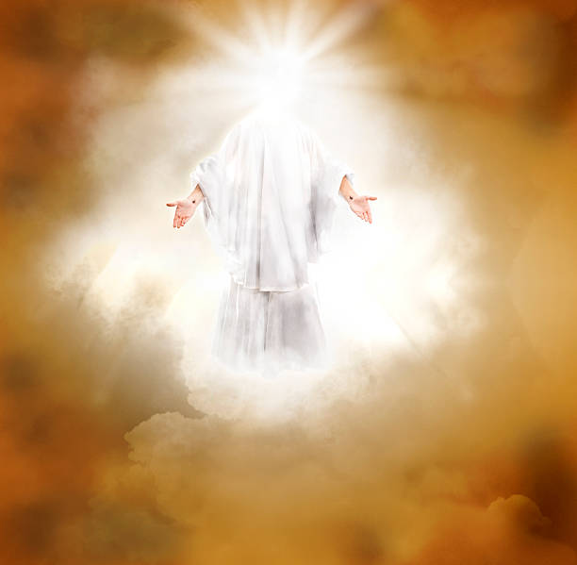

Slide 35
NEXT CLASS – 9 Feb 2022
Book of Galatians
Before next class, read the below verses in the KJV and the NIV, plus one additional versions of the Bible, i.e., NRSV, NLT, NKJV, etc …
Chapter 2:1 – 10
“A Gospel Worth Accepting and Affirming”

